Slide 1
When Tiramisu meets Online Fashion Retail
Elena Terenzi (@RompTer)
Patty Ryan(@singingdata)
Chew-Yean Yam (www.linkedin.com/in/cyyam)
Microsoft

Slide 2
Who We Are
740-person global software engineering team
Working with Partners around the globe
Across numerous disciplines
On really hard problems
And sharing the solutions
ML Contributors (MSFT): Olivia Klose, Tempest Van Schaik, Sachin Kundu
Operationalization and UI Contributors (MSFT): Erica Barone, David Douglas, Shashank Banerjea

Slide 3






Working With Partners

Slide 4

Sharing OUR Solutions
Code Stories on our ‘Developer Blog’
http://Microsoft.com/developerblog
Fashion Retail Inventory Management with Deep Learning
Deep Learning Image Segmentation for visual search
Open-Source Repos
You’ll see GitHub links in this talk
All code is MIT Licensed
Talks, like this one

Slide 5
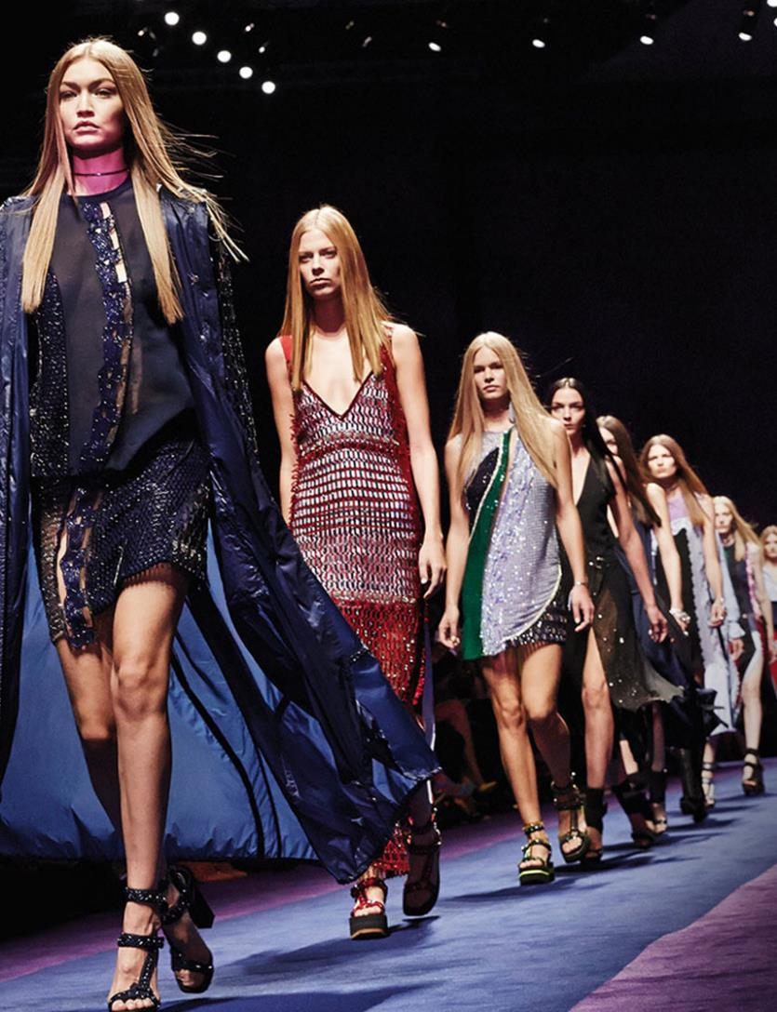
Visual Search in Fashion
Inventory management drives one of the largest expenses for retailers
Problem compounded for big online fashion retailers cataloging every newly piece of apparel
Warehouse inventory management presents unique challenges
Task complex even for a human

Slide 6
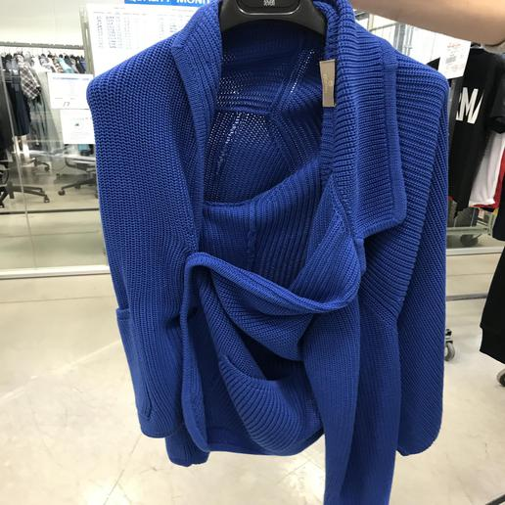
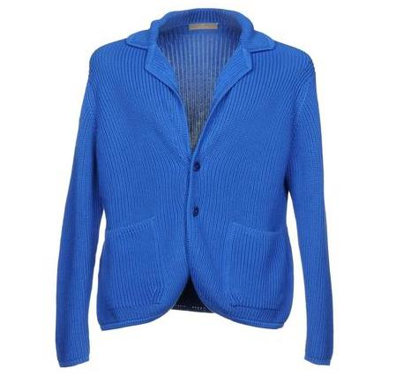
If you were in their shoes…
Given:
Find:

Slide 7
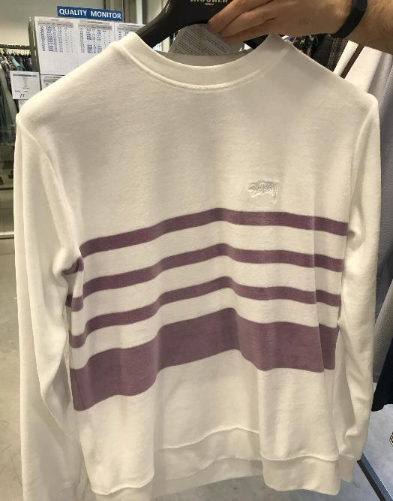
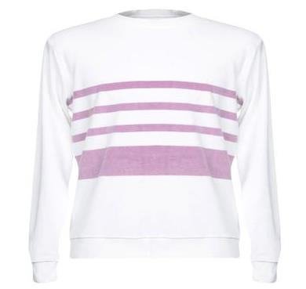
If you were in their shoes…
Given:
Find:

Slide 8
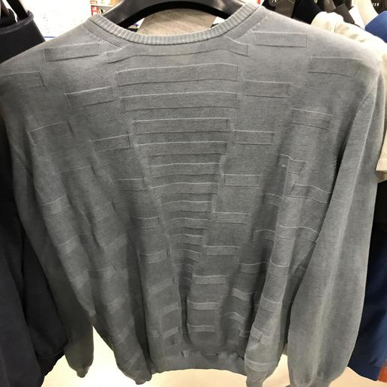
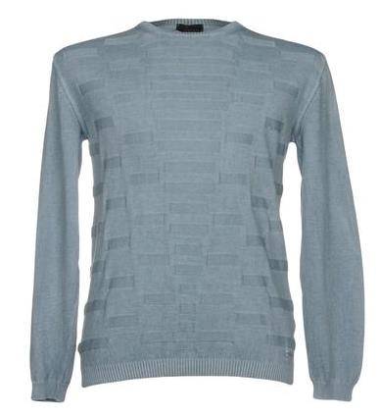
If you were in their shoes…
Given:
Find:

Slide 9
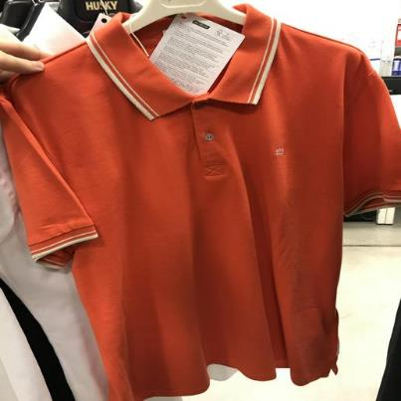
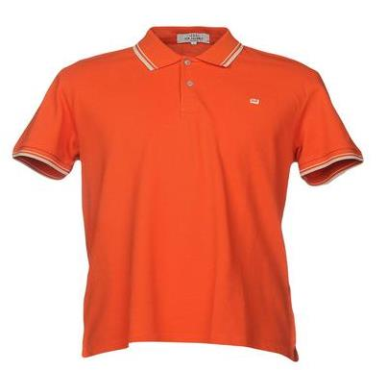
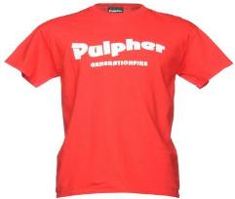
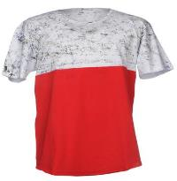
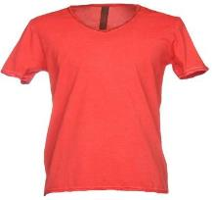
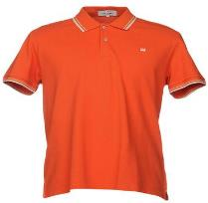
If you were in their shoes…
Given:
Find:
From:

Slide 10
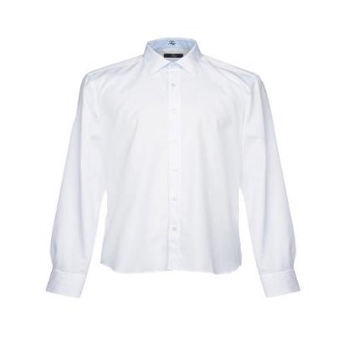
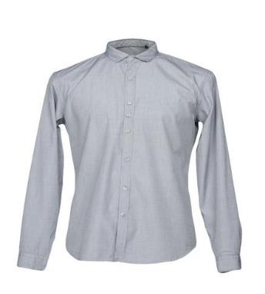
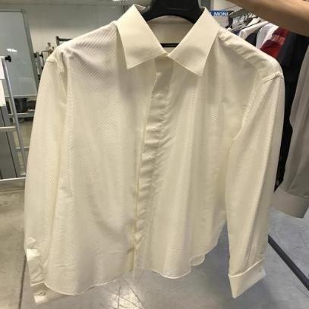
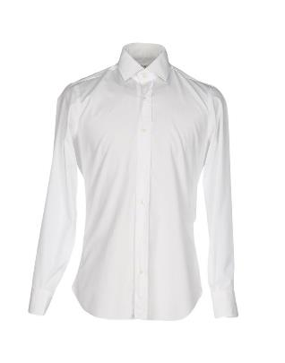
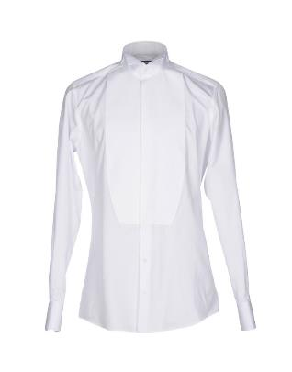
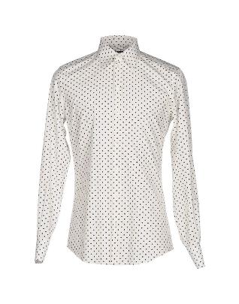
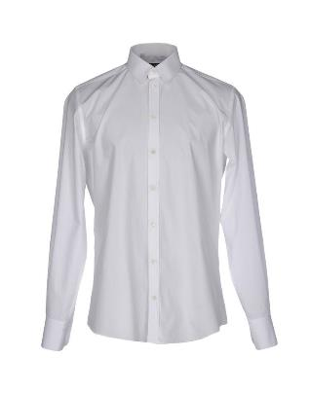
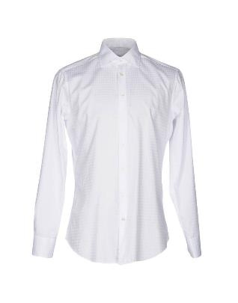
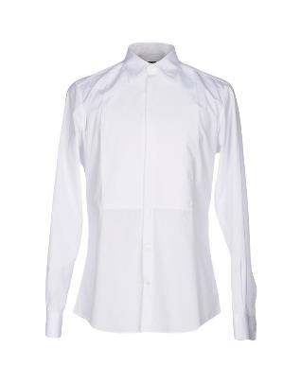
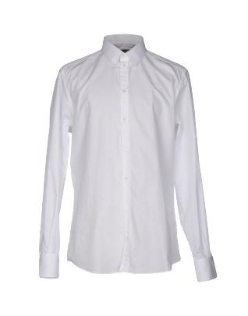
If you were in their shoes…
Given:
Find:
From:

Slide 11
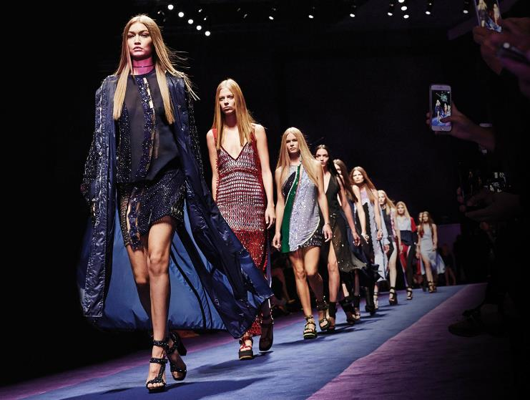
MANY MORE Applications of Visual Search
Auto-tagging of apparel
Consumer search for catalogs
Recommendation engines
A Few DL Trends in Fashion
Zalando ‘Street to Shop’
Bing Visual Search
Alibaba Fashion AI

Slide 12
A Few TECHNICAL Challenges
Widely variant image quality and context
Variant background creates confusion - segmentation
Correct result within top n most similar
Human factor in selection of match
Labeling automation and inconsistencies
Active learning

Slide 13
A Few TECHNICAL Challenges
Widely variant image quality and context
Variant background creates confusion - segmentation
Correct result within top n most similar
Human factor in selection of match
Labeling automation and inconsistencies
Active learning
This Talk

Slide 14
Image similarity Project pipeline
Select Catalogue of Apparel
Generate Segmentation Labels
(Human Augmented Task w/ GrabCut)
Automatic Segmentation
Train/Test
Image Similarity (Euclidean distance)
Generate Snapshot Samples
(Human Task)
Feature Extraction
CV/CNNs

Slide 15


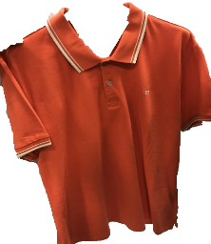
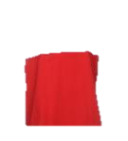
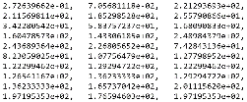
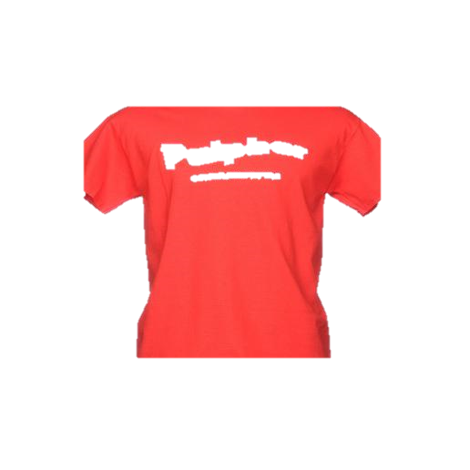

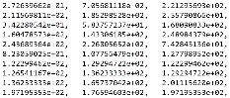
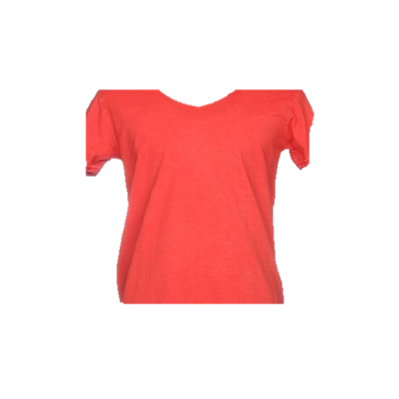
Functional View of Image Retrieval
Item Snapshot
Segmentation
Segmented Snapshot
Compressed Representation of Item without Background
Compare to compressed image catalogue and derive Similarity Measure
Top N most similar results

Slide 16
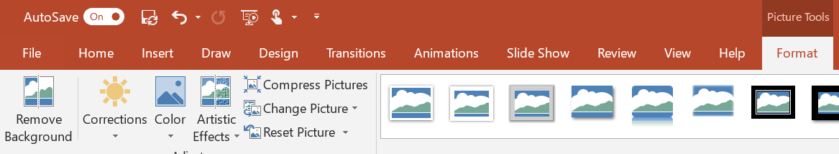
Semantic segmentation
Widely used in healthcare to identify organs from 2D/3D scans of body
Microsoft Research Cambridge: InnerEye https://www.microsoft.com/en-us/research/project/medical-image-analysis/
Has been around for a long time without the need to use Deep Learning (Computer Vision Techniques)
Photo editing tools had this feature for decades (has been mostly manual since recently)
PowerPoint
more recently Instagram
Today Deep Learning can improve it
Microsoft works with Adobe to improve background removal https://www.digitaltrends.com/photography/mit-adobe-microsoft-background-removal-ai/

Slide 17
Semi-Automated Tool: Grabcut
More about GrabCut
Designed in 2004 by Carsten Rother, Vladimir Kolmogorov & Andrew Blake from Microsoft Research Cambridge, UK
"GrabCut": interactive foreground extraction using iterated graph cuts
Included in OpenCV
For our task ~5 min per image to created a labeled image
Taken from OpenCV Tutorial: Segmenting an image using the grabcut Algorithm | packtpub.com
https://www.youtube.com/watch?v=aOqOwM-Qbtg

Slide 18
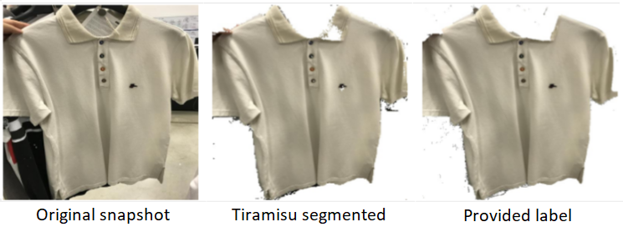
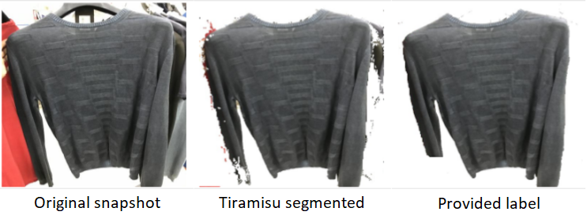
FULLy Automated: DeeP LEARNING
Deep Learning Approaches
Training the network to recognize background
Fully Convolutional DenseNets like Tiramisu where output is concatenated to input
Benefit
Dramatically increases image similarity accuracy and precision
Eliminates human labeling task and time

Slide 19
Image similarity Project pipeline
Select Catalogue of Apparel
Generate Segmentation Labels
(Human Augmented Task w/ GrabCut)
Automatic Segmentation
Train/Test
Feature Extraction
CV/CNNs
Image Similarity (Euclidean distance)
Generate Snapshot Samples
(Human Task)
We did semi/weakly supervised semantic segmentation with Grabcut

Slide 20
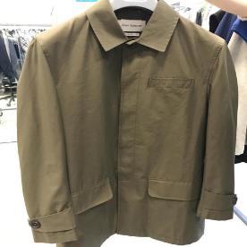
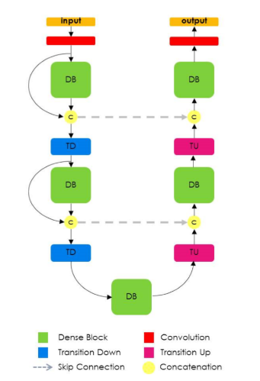
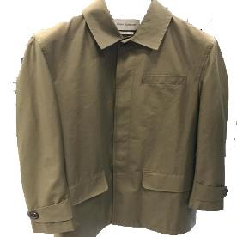

Tiramisu Semantic Segmentation Deep Learning
Works on Low Fidelity Image, Small Sample Segmentation Problems
100 Samples
Mobile Snapshots
75/25
Train/Test Split
100 Samples
Labeled Mask

Slide 21
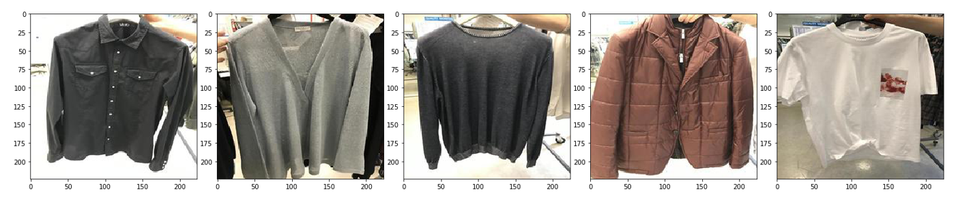
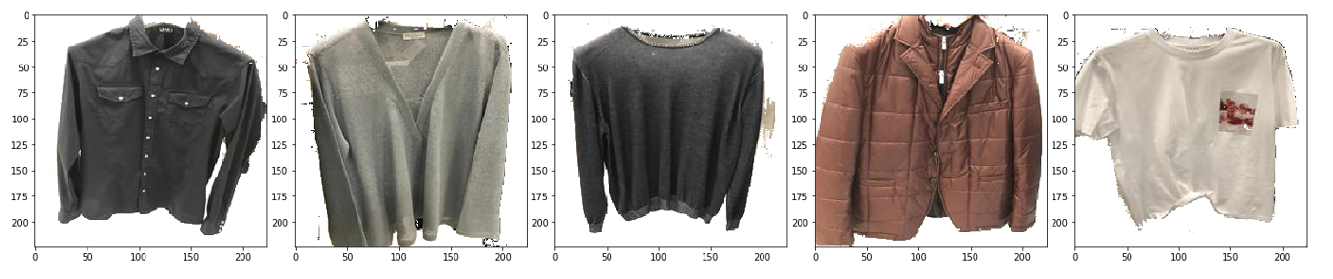
Tiramisu Semantic Segmentation Deep Learning
Output – Good Outcome Selection at 100 Epochs of Segmentation of Apparel Item and Background

Slide 22
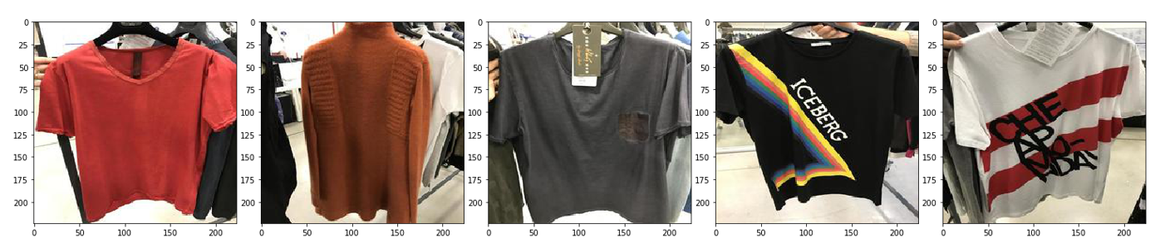
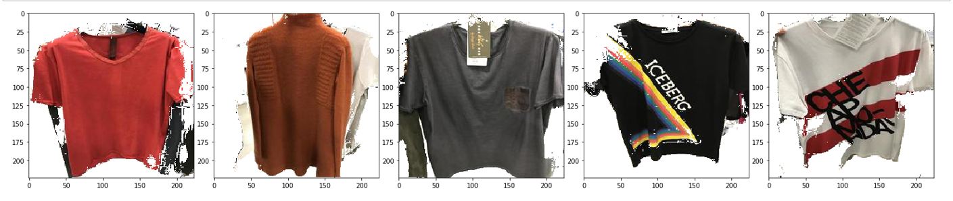
Tiramisu Semantic Segmentation Deep Learning
Output – Poor Outcome Selection at 100 Epochs of Segmentation of Apparel Item and Background

Slide 23
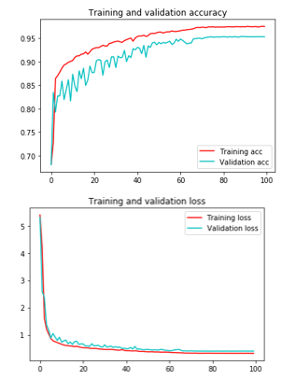
DEMO Time
All notebooks on Github
https://github.com/CatalystCode/image-segmentation-using-tiramisu/blob/master/JupyterNotebooks

Slide 24
gotchas
Real-world challenges: taking pictures for training in operation...
Weakly supervised segmentation is weak as ground truth not perfect
Multi-class in real world vs binary segmenter simplification
Memory intensive (dense nets) : to keep the same network architecture we had to use a low image resolution (224x224) and reduce batch size (6 to 4)
Managing retraining and active learning in operation

Slide 25
Functional View of Image Retrieval
Item Snapshot
Segmentation
Segmented Snapshot
Compressed Representation of Item without Background
Compare to compressed image catalogue and derive Similarity Measure
Top N most similar results

Slide 26
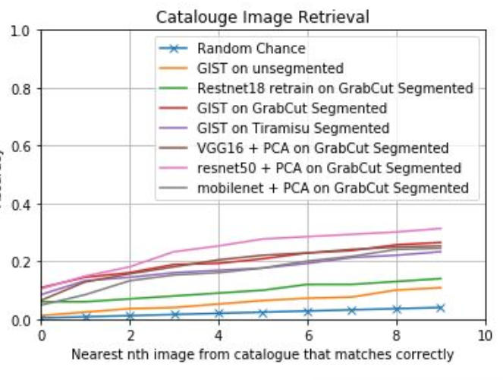
Results & Next Steps
Results
Accuracy in top 10 modest, however time savings still substantial
Partner using image similarity DL transfer learning in operation
Next Steps
Detecting Deeper Apparel Specific Semantic Features
style, pattern, texture, sleeve, collar
Better Expressing Similarity with Deep Ranking
Active learning to improve labeling and coverage
Consumer-facing visual search
https://github.com/CatalystCode/image-retrieval-online-retail

Slide 27
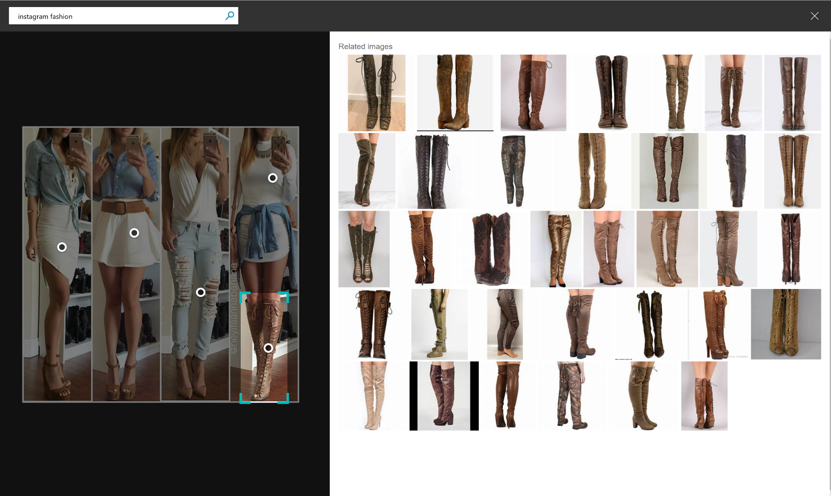
Microsoft’s BING Search
https://www.bing.com/images/search

Slide 28
Conclusion
Implementing deep leaning in industry is easier than ever before
Partner designed and operationalized in less than six months
Content Management, Labeling and Active Learning present challenges
Now blocks on labeled data
Operationalization Considerations
Distributed computation for training
Dockerized deployment for easy re-use

Slide 29

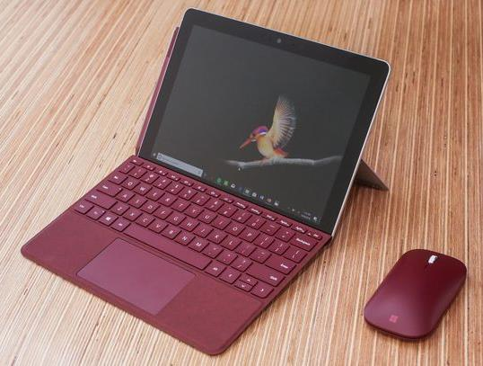



Visit us at Booth #1221
Win a Surface Go
Meet Microsoft experts and authors,
Anand Raman and Wee Hyong Tok
DAILY PRIZE DRAWS
Tuesday 9/11 6:00pm
Wednesday 9/12 6:30pm
Thursday 9/13 3:00pm
Wednesday 9/12, 3:00PM to 4:30PM
and get an autographed book!

Slide 30
Thank You!
Questions?
Links
Link to slides - This talk, links to resources
Github repos
https://github.com/CatalystCode/image-segmentation-using-tiramisu/
https://github.com/CatalystCode/image-retrieval-online-retail
Blog Posts
Fashion Retail Inventory Management with DL Content-based Image Retrieval
Deep Learning Image Segmentation for Ecommerce Catalogue Visual Search
Interesting links:
Background removal with deep learning
Heart Disease Diagnosis with Deep Learning
Semantic Segmentation using Fully Convolutional Networks over the years

